Slide 1
Gravity and motion
Gravitational acceleration
Newton’s Law of Universal Gravitation
Gravitational fields
Work in gravitational fields
Motion on inclined planes
Projectile motion
Circular motion
Kepler’s laws
Torque
Equilibrium
Artificial satellites

Slide 2


SCSA ATAR Syllabus (last updated 30/10/18; https://senior-secondary.scsa.wa.edu.au/syllabus-and-support-materials/science/physics)
Science Understanding
the movement of free-falling bodies in Earth’s gravitational field is predictable
all objects with mass attract on another with a gravitational force; the magnitude of this force can be calculated using Newton’s Law of Universal Gravitation This includes applying the relationship
$$F_{g}=G\frac{m_{1}m_{2}}{r^{2}}$$
objects with mass produce a gravitational field in the space that surrounds them; field theory attributes the gravitational force on an object to the presence of a gravitational field This includes applying the relationship
$$F_{weight}=mg$$
when a mass moves of is moved from one point to another in a gravitational field and its potential energy changes, work is done on the mass by the field This includes applying the relationships
$E_{p}=mg∆h$, $W=Fs$, $W=∆E$, $E_{k}=\frac{1}{2}mv^{2}$
gravitational field strength is defined as the net force per unit mass at a particular point in the field This includes applying the relationship
$$g=\frac{F_{g}}{m}=G\frac{M}{r^{2}}$$
the vector nature of the gravitational force can be used to analyse motion on inclined planes by considering the components of the gravitational force (that is, weight) parallel and perpendicular to the plane
projectile motion can be analysed quantitatively by treating the horizontal and vertical components of the motion independently This includes applying the relationships
$v_{av}=\frac{s}{t}$, $a=\frac{v−u}{t}$, $v=u+at$, $s=ut+\frac{1}{2}at^{2}$, $v^{2}=u^{2}+2as$, $E_{k}=\frac{1}{2}mv^{2}$
when an object experiences a net force of constant magnitude perpendicular to its velocity, it will undergo a uniform circular motion, including circular motion on a horizontal plane and around a banked track; and vertical circular motion This includes applying the relationships
$v=\frac{2πr}{T}$, $a_{c}=\frac{v^{2}}{r}$, $resultant F_{c}=ma_{c}=\frac{mv^{2}}{r}$
Newton’s Law of Universal Gravitation is used to explain Kepler’s laws of planetary motion and to describe the motion of planets and other satellites, modelled as uniform circular motion This includes deriving and applying the relationship
$$\frac{T2}{r3}=\frac{4π2}{GM}$$
when an object experiences a net force at a distance from a pivot and at an angle to the lever arm, it will experience a torque or moment about that point This includes applying the relationship
$$τ=rF\sin{θ}$$
for a rigid body to be in equilibrium, the sum of the forces and the sum of the moments must be zero This includes applying the relationships
$\sum{F=0}$, $τ=rF\sin{θ}$, $\sum{τ=0}$
Science as a Human Endeavour
Artificial satellites are used for communication, navigation, remote-sensing and research. Their orbits and uses are classified by altitude (low, medium or high Earth orbits) and by inclination (equatorial, polar and sun-synchronous orbits). Communication via satellite is now used for global positioning systems (GPS), satellites phones and television. Navigation services support management and monitoring of traffic and aircraft movement. Geographic information science uses data from satellites to monitor population movement, biodiversity and ocean currents.

Slide 3
Revision of year 11 motion
Complete : Revision on Law of Conservation of Energy and Vectors pg 37-40 in booklet
Also in end of Year 11 booklet

Slide 4
Generalised method for tackling motion problems
Draw a diagram
Assign values to variables (v, u, t, a, s etc.)
Assign direction (typically up is positive, down is negative, right is positive, left is negative)
Select appropriate equation, substitute variables, solve for unknown
Write answer to 3 s.f. with direction as appropriate

Slide 5

Example 1
A rock is dropped out of a hot air balloon that is hovering stationary 200m above the ground.
With what speed does the rock hit the ground?
$$v2=u2+2as$$
$$v=\sqrt{0+2×9.8×200}=62.6 m s^{−1}$$
How long does the rock take to fall?
$$s=ut+\frac{1}{2}at2$$
$$200=0+4.9t2$$
$$t=6.39 s$$
c) If the hot air balloon is moving upwards at 5.00 ms-1 how long would the rock take to drop 200m?
$$s=ut+\frac{1}{2}at2$$
200$=−5t+4.9t2$ (quadratic)
0$=4.9t2$ -5t -200
t = 6.92 s

Slide 6

Example 2
A rocket takes off vertically upwards at 15.0 ms⁻¹ .
What is the maximum height reached by the rocket?
$$v2=u2+2as$$
$$0=152+2×−9.8s$$
$s=11.5 m$
How long will the rocket take to fall back to its original position?
$$a=\frac{v−u}{t}$$
$$−9.8=\frac{0−15}{tup}$$
$$tup=1.53 s$$
$$t=2tup=3.06 s$$

Slide 7

Example 3
A boy takes a shot with a basketball with a vertical velocity of 6.50 m s⁻¹ and watches as it comes down through the hoop, 1.05 m above his hand.
Find the total flight time for the ball from hand to hoop.
$$sup=ut \frac{1}{2}at_{}^{2}$$
$$+1.05=+6.5t− \frac{1}{2}9.8t_{}^{2}$$
$$0=−4.9t_{}^{2}+6.5t −1.05$$
$$t=1.14 s (on the way down)$$
Find the velocity of the ball as it passes the hoop.
$on the way down v=+6.50+\left(−9.8 X 1.138\right)=−4.65 m s^{−1}$ $=4.65 m s^{−1}$ down
An opponent is running towards the hoop at 35 km/h. He is 15.0 m away from being in position to grab the ball as it rebounds. Will he be there in time?
$$s=vt=\frac{35}{3.6}×1.14=11.1m so no$$

Slide 8

Example 4
A car is accelerated from 15.0 m s⁻¹ to 48.0 m s⁻¹ in 12 s.
Calculate the average velocity
$$vav=\frac{48+15}{2}=31.5 m s^{−1}$$
Calculate acceleration
$a=\frac{48−15}{12}=2.75 m s^{−2}$ forwards
Calculate displacement
$$s=ut+\frac{1}{2}at2=15×12+2.75/2×{12}^{2}=378 m$$

Slide 9



Free body diagram examples
normal
lift
thrust
drag
thrust
drag
friction
weight
weight
weight

Slide 10

Potential energy
All objects in a gravitational field have potential energy as a result of their position within the field
When an object moves through a gravitational field causing its potential energy to change, work has been done on it by the field
Recall the following equations:
$E_{p}=mg∆h$ $W=Fs$ $W=∆E$ $E_{k}=\frac{1}{2}mv^{2}$

Slide 11
Gravitational acceleration
Ignoring air resistance all objects on Earth accelerate towards the center of the Earth in a consistent manner
A value of 9.8 m s⁻² is used as an average value for gravitational acceleration but there is local variation
(https://giphy.com/gifs/ball-watch-bowling-5EgxGpMU8jFZK)

Slide 12
Acceleration down a slope
Vertical gravitational acceleration is at 9.8 ms⁻²
An object on a slope will accelerate at a slower rate
The acceleration down a slope due to gravity is the component of gravity acting parallel to the slope (ignore friction)

Slide 13

The acceleration down the slope is the component of gravitational acceleration acting parallel to the slope
$$g_{parallel}=g\sin{θ}$$
Should always be less than 9.8 ms⁻²
g_{parallel}
g
g_{perpendicular}
θ
θ

Slide 14
Example
Determine the driving force applied to a 1 580 kg car moving at 60.0 kmh⁻¹ up a slope with an angle of 5.80^{0.} The frictional force is 1020 N.
Ans: 2 584.8 N = 2580N

Slide 15

Projectile motion
Motion of projectiles through two dimensions can be handled very effectively by considering vertical and horizontal components separately
Use normal equations of motion:
$v_{av}=\frac{s}{t}$ $a=\frac{v−u}{t}$ $v=u+at$ $s=ut+\frac{1}{2}at^{2}$ $v^{2}=u^{2}+2as$ $E_{k}=\frac{1}{2}mv^{2}$
Vertical component typically used to find time of flight, normally work out vertical component first
Gravitational acceleration typically results in a parabolic projectile path

Slide 16
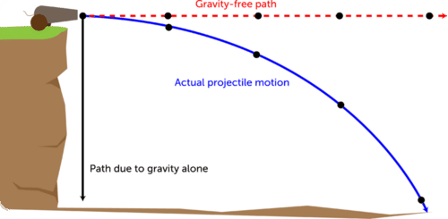
Projectile motion forces
Projectile motion often defined as when the only force acting on an object is gravity (weight)
Friction (air resistance) is still present but typically ignored in calculations
No thrust force! Once a cannonball has exited the cannon it is not subjected to any forwards force
(https://www.ck12.org/physics/projectile-motion/lesson/Projectile-Motion-MS-PS/)

Slide 17

Example 1
A 5.7 kg cannonball is fired horizontally from the top of a 15 m cliff with a muzzle velocity of 212 m s⁻¹. How far does the cannonball travel?
First find time of flight using only vertical component of motion
$$s=ut+\frac{1}{2}at^{2}$$
$$15=0t+\frac{1}{2}9.8t2$$
$$t=1.7496 s$$
Then distance can be found
$$s=vt=212×1.7496=371 m$$

Slide 18
Example 2
Bob Beamon’s record breaking long jump (8.9 m) in the 1968 Olympics resulted from an initial velocity of 9.5 m s⁻¹ at an angle of 40◦ to the horizontal. Determine the following.
a) u_{v}
6.065 m s⁻¹
b) u_{h}
7.27742 m s⁻¹
c) t
1.24622 s
d) Range
9.07 m
e) Max height
1.90 m

Slide 19
Example 3
A golfer hits a ball with a velocity of 25 m s⁻¹ at an angle of 60◦ to the horizontal. Determine the following.
a) u_{v}
21.6506 m s⁻¹
b) u_{h}
12.5 m s⁻¹
c) t
4.418496958 s
d) Range
55.2 m
e) Max height
23.9 m

Slide 20
Example 4
A footballer kicks a ball at 30 m s⁻¹ at an angle of 30◦ to the horizontal. Determine the following.
a) u_{v}
15 m s⁻¹
b) u_{h}
25.98076211 m s⁻¹
c) t
3.06122449 s
d) Range
79.5 m
e) Max height
11.5 m

Slide 21
Example 5
A diver runs and dives off a 10 m high tower with a velocity of 4.0 m s⁻¹ at an angle of 70◦ to the horizontal. Determine:
Maximum height reached.
10.7 m
b) Horizontal distance to reach maximum height.
0.525 m
c) Total distance travelled horizontally
2.55 m
d) Total time in the air
1.862711759 s
e) Velocity on landing.
v_{v}=-14.49580476 v_{h}=1.368080573 v= 15.0 m s⁻¹ 5.42° from vertical

Slide 22
Air resistance
Ignoring air resistance the path of projectile is parabolic.
Air resistance opposes the direction of motion of projectile. It has the following effects on the pathway of projectile.
Reduce its maximum height and peaks earlier
Reduce its calculated range
Increase angle of descent.
Draw a diagram of soccer ball being kicked to make a goal with pathway a) ignoring air resistance and pathway b) including air resistance.

Slide 23
Applying air resistance
For a projectile moving in air:
Why is the angle of descent greater than the angle of projection?
Is the time on upward journey different to time on downward journey? (Hint: consider vertical forces acting on projectile up and down)

Slide 24
Circular motion
If an object experiences a net force of constant magnitude perpendicular to its velocity it will undergo uniform circular motion
weight towards center of Earth perpendicular to instantaneous velocity
instantaneous velocity

Slide 25
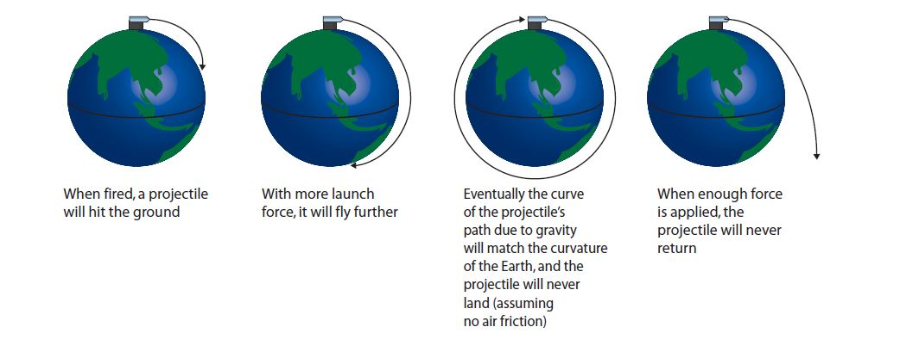
(http://www.hscstudyguides.com.au/hsc-physics-course-summary/hsc-physics-course-summary-space/rocket-launches-orbital-motion/)

Slide 26
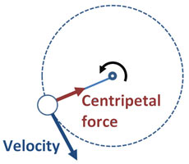

Velocity in circular motion
$$v=\frac{2πr}{T}$$
$$v=velocity \left(m s^{−1}\right)$$
$$r=radius \left(m\right)$$
$$T=period (s)$$
Simply a version of $speed=\frac{distance}{time}$
2πr is the circumference so distance travelled in a complete loop
T is the time taken for a complete loop
Instantaneous velocity will always have a direction tangential to the circular path
Recall that $T=\frac{1}{f}$
(http://www.sciencekids.co.nz/experiments/bucketspinning.html)

Slide 27

Example 1
If it takes the moon 27.32 days to orbit the Earth, how fast is it travelling? Assume Earth-Moon distance on data sheet is center to center.
$$v=\frac{2πr}{T}=\frac{2π3.84×108}{27.32×24×60×60}=1020 m s^{−1}$$

Slide 28

Acceleration in circular motion
$$a_{c}=\frac{v^{2}}{r}$$
$$a_{c}=centripetal acceleration \left(m s^{−2}\right)$$
$$v=velocity \left(m s^{−1}\right)$$
$$r=radius (m)$$
Much more complicated to derive but results in very simple equation
Centripetal refers to the direction, that is, perpendicular to the direction of movement, directly towards the center of curvature
(http://www.sciencekids.co.nz/experiments/bucketspinning.html)

Slide 29

Example 1
A train is travelling at 50 m s⁻¹ round a curve of radius 6000 m. What is its acceleration?
$$a=0.417 m s^{−2} towards the center of the curve$$

Slide 30
Example 2
A washing machine spins its drum at 1200 rpm. The diameter of the drum is 35 cm.
a) Find the acceleration of the tub.
b) Find the speed of the rim of the tub.

Slide 31

Force in circular motion
$$resultant F_{c}=ma_{c}=\frac{mv^{2}}{r}$$
$$F_{c}=centripetal force \left(N\right)$$
$$a_{c}=centripetal acceleration \left(m s^{−2}\right)$$
$$v=velocity \left(m s^{−1}\right)$$
$$r=radius (m)$$
Derived from 2nd law and centripetal acceleration equation
Once again direction is always towards the center of curvature, perpendicular to the instantaneous velocity
(http://www.sciencekids.co.nz/experiments/bucketspinning.html)

Slide 32

Example 1
A 900 kg car moving at 10 m s⁻¹ takes a turn around a circle with a radius of 25 m. Determine the acceleration and the net force acting upon the car.
$$a=4 m s^{−1}$$
$$F=3600 N$$

Slide 33

Example 2
A 95 kg footballer makes a turn on the pitch. They sweep out a path which is a portion of a circle with a radius or 12 m. The footballer makes a quarter turn around the circle in 2.1 s. Determine the speed, acceleration and net force acting upon the halfback.
$$v=8.98 m s^{−1}$$
$$a=6.71 m s^{−2}$$
$$F=638 N$$

Slide 34
Horizontal plane circular motion
Simplest scenario as normal force and centripetal force are always perpendicular so entirely independent
For a moving object to corner (change direction) it has to experience a force in the direction it is turning
For a car on flat ground the only source of this force can be friction, if not enough friction between the car and the ground it will skid out
(https://giphy.com/gifs/on-fails-caught-e8ojIgE5pyr2U)

Slide 35

Example 1
A swingball with a mass of 57 g is swinging freely in a horizontal circular path. The cord is 15 m long and is at an angle of 60◦ to the vertical. Draw a diagram to find the following.
Radius of the ball’s path $13.0 m$
Net Force acting on the ball $0.968 N towards center of circle$
Tension in the cord $1.12 N along the cord$
Speed of the ball
$$14.8 m s^{−1}$$

Slide 36
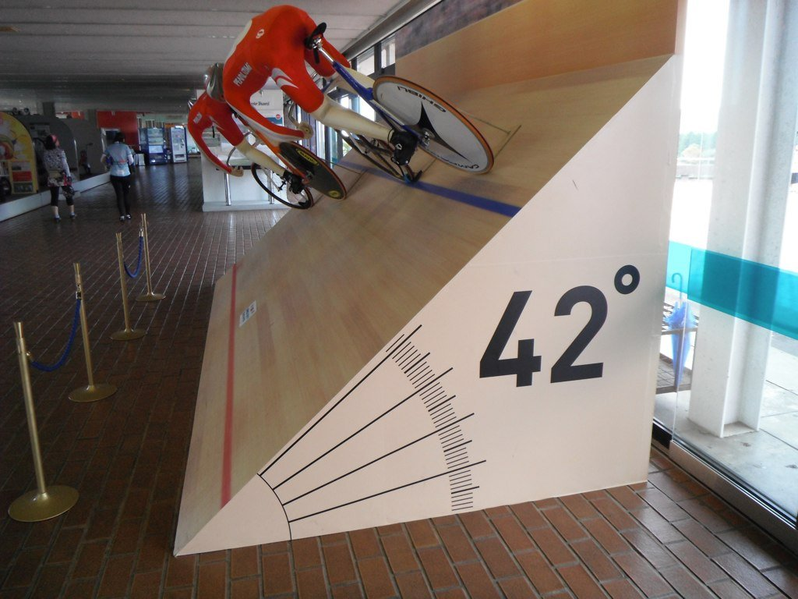
Banked track circular motion
To allow vehicles to take corners more quickly racetracks have banked turns
Normal force is no longer perpendicular to the centripetal force so it contributes to it, allowing for faster cornering
If N_{h}=F_{C} for a particular turn, it can be made on a perfectly frictionless surface
If N_{h}>F_{C} then vehicle needs friction to prevent it from sliding inwards
If N_{h}<F_{C} then vehicle needs friction to prevent it from sliding outwards
(https://www.reddit.com/r/bicycling/comments/16d11t/indoor_track_cross_section_of_bank)

Slide 37
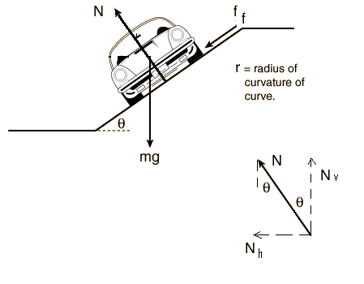

Banked track calculations
Normal force increased during circular motion such that the horizontal component of the normal force supplies the centripetal force
Conveniently the vertical component of the normal force becomes equal to the weight force
$$Nh=mg\tan{θ}$$
Typically assume 0 friction so
$$FC=Nh=mg\tan{θ}=\frac{mv^{2}}{r}$$

Slide 38
Banked track applied to other contexts
Same calculations apply to:
a runner leaning into a corner (reaction force replaces normal)
banking aircraft (lift replaces normal)
pendulum (tension replaces normal)

Slide 39
Example
A 1250 kg car travels on a roadway that is banked at an angle of 25.0⁰ to the horizontal. The radius of the circular roadway is 52.0 m
Determine the net force if the car is moving at the designed speed.
What is the designed speed for the banked roadway?

Slide 40

Vertical plane circular motion – bucket on rope
In circular motion in a vertical plane weight is sometimes in the opposite direction to the centripetal force, is sometimes in the same direction, and is sometimes perpendicular; most complex scenario
Weight is opposite direction as centripetal force so $tension=\left|centripetal force\right|+\left|weight\right|$
Weight is perpendicular to centripetal force so $tension=centripetal force$
Weight is same direction as centripetal force so $tension=\left|centripetal force\right|−\left|weight\right|$
3
2
1

Slide 41

Vertical plane circular motion – Loop-the-loop
In circular motion in a vertical plane weight is sometimes in the opposite direction to the centripetal force, is sometimes in the same direction, and is sometimes perpendicular; most complex scenario
Weight is opposite direction as centripetal force so $reactionforce=\left|centripetal force\right|+\left|weight\right|$
Weight is perpendicular to centripetal force so $reaction force=centripetal force$
Weight is same direction as centripetal force so $reaction force=\left|centripetal force\right|−\left|weight\right|$
3
2
1

Slide 42

Vertical plane circular motion – minimum speed Loop-the-loop
Any loop has a minimum speed needed to make the loop
Occurs when the reaction force is 0 therefore
Since weight is same direction as centripetal force $reaction force=\left|centripetal force\right|−\left|weight\right|$
$$0=\left|centripetal force\right|−\left|weight\right|$$
$$\frac{mv^{2}}{r}=mg$$
If a vehicle attempts the loop at a lower speed it will fall
3
2
1

Slide 43
Example 1
A 150 g ball on the end of a 110 cm line if swung in a vertical circle.
a) Determine the minimum speed the ball must have at the top of the arc.
3.28 m s⁻¹
b) Calculate the tension in the line at the bottom of the arc assuming the ball is moving at twice the speed at the top.
735 N

Slide 44
Example 2
The radius of the loop is 10 m, the mass of the car is 150 kg. Find the reaction forces at A and B assuming no energy is lost.
A reaction= 13200 N up
B reaction = 4410 N down
Start
A
40 m
B

Slide 45
Example 3
At what speed will a 1500 kg car experience lift-off on a speed bump of radius 2.5 m?
>4.95 m s⁻¹

Slide 46
Gravitational acceleration
Ignoring air resistance all objects on Earth accelerate towards the center of the Earth in a consistent manner
A value of 9.8 m s⁻² is used as an average value for gravitational acceleration but there is local variation
(https://giphy.com/gifs/ball-watch-bowling-5EgxGpMU8jFZK)

Slide 47

Newton’s law of universal gravitation
Newton came to the conclusion that all masses attract each other at a distance, with size of the force being proportional to the masses and inversely proportional to the square of the distance between them
$$F_{g}=G\frac{m_{1}m_{2}}{r^{2}}$$
$$Fg=gravitational force \left(N\right)$$
$$G=6.67×{10}^{−11} N m2 {kg}^{−2}=Newtonian constant of gravitation \left(N m2 {kg}^{−2}\right)$$
$$m1=mass of object 1 \left(kg\right)$$
$$m2=mass of object 2 \left(kg\right)$$
$$r=distance between objects (m)$$
Newton never devised a satisfactory explanation for why or how gravity acted on distant objects but his equation is extremely effective at predicting what gravity does to distant objects

Slide 48

Newton’s law of universal gravitation and g
Newton’s Law of Universal Gravitation can be used to determine the acceleration of any mass on Earth using the values for the Newtonian constant of gravitation, mass of the Earth and mean radius of the Earth off the data sheet
$$g=\frac{F_{g}}{m2}=G\frac{m_{1}m_{2}}{r^{2}}÷m2$$
$$g=G\frac{m_{1}}{r^{2}}=6.67×{10}^{−11}\frac{5.97×1024}{\left(6.37×106\right)2}=9.81 m s^{−2}$$
A familiar number, however it relies on mean radius of the Earth and assumes the mass of the Earth is homogenously distributed throughout the Earth or even that it is all located at the centre of the Earth

Slide 49

Factors influencing local gravitational acceleration
$$F_{g}=G\frac{m_{1}m_{2}}{r^{2}}$$
Altitude; the radius variable is referring to distance from the center of the Earth. Planes at cruising altitude will experience slightly diminished gravitational acceleration.
Latitude; the Earth is not a true sphere, the radius at the poles is slightly less than that at the equator making gravitational acceleration slightly higher at the poles
Local geology; the Earth’s mass is not homogenously distributed. If higher density rocks are present underfoot the gravity will be slightly higher (very small effect but measurable, used in mineral exploration)

Slide 50
Action at a distance
It is inconceivable that inanimate Matter should, without the Mediation of something else, which is not material, operate upon, and affect other matter without mutual Contact…That Gravity should be innate, inherent and essential to Matter, so that one body may act upon another at a distance thro' a Vacuum, without the Mediation of any thing else, by and through which their Action and Force may be conveyed from one to another, is to me so great an Absurdity that I believe no Man who has in philosophical Matters a competent Faculty of thinking can ever fall into it. Gravity must be caused by an Agent acting constantly according to certain laws; but whether this Agent be material or immaterial, I have left to the Consideration of my readers.
— Isaac Newton, Letters to Bentley, 1692/3
(Berkovitz, Joseph (2008). "Action at a Distance in Quantum Mechanics". In Edward N. Zalta. The Stanford Encyclopedia of Philosophy (Winter 2008 ed.)

Slide 51
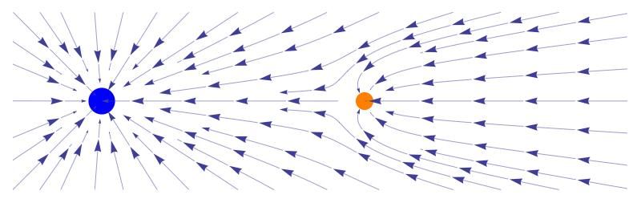
Field theory
Idea that mass creates a gravitational field that pulls other mass towards it at a distance
At any point in space the gravitational acceleration experienced by an object is equal to the sum of each of the contributions from different masses
(http://diaryofnumbers.blogspot.com/2011/02/bill-oreilly-problem.html)

Slide 52
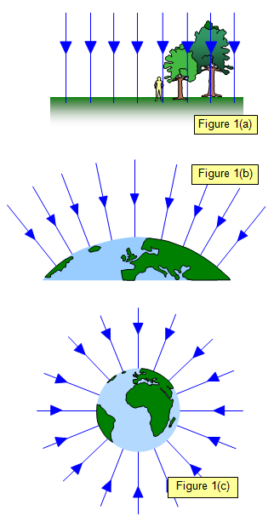
Field lines
Field strength increases as lines become closer together
At the large scale gravitational fields are radial, with field lines converging at the center of mass
At the small scale the field appears uniform with even spacing of “parallel” field lines
(http://www.schoolphysics.co.uk/age16-19/Mechanics/Gravitation/text/ Gravitational_field_intensity/index.html)

Slide 53

Field strength away from the surface of the Earth
$$g=\frac{F_{g}}{m}=G\frac{M}{r^{2}}$$
Field strength defined as the net force per unit mass at a particular point in a field
Force per unit mass is equal to acceleration
Can be used to determine field strength at points above or below the surface of the Earth, or even other large objects (moons/planets/stars)
If multiple large bodies are present simply sum the components from each one as vectors

Slide 54

Example 1
Determine the gravitational field strength experienced by a plane at a high cruising altitude (12.5 km)
$$g=G\frac{M}{r^{2}}=6.67×{10}^{−11}\frac{5.97×1024}{\left(6.37×106+12500\right)2}=9.78 m s^{−2}$$

Slide 55

Example 2
What is the gravitational field strength experienced by an object directly between the Earth and Moon, 3.742 x 10⁷ m above the surface of the Moon
$$gtotal=G\left(\frac{MEarth}{{rEarth}^{2}}−\frac{MMoon}{{rMoon}^{2}}\right)$$
$$gtotal=G\left(\frac{5.97×1024}{\left(3.84×108−(3.742×107+1.74×106)\right)2}−\frac{7.35×1022}{{(3.742×107+1.74×106)}^{2}}\right)$$
$$gtotal=G\left(4.79×107−4.79×107\right)$$
$$gtotal=0 m s^{−2}$$

Slide 56
Kepler’s laws of planetary motion
Describe the motion of planets around the Sun, extend to any satellite
The orbit of a planet is an ellipse with the Sun at one of the two foci
A line segment joining a planet and the Sun sweeps out equal areas during equal intervals of time
The square of the orbital period of a planet is proportional to the cube of the semi-major axis of its orbit
For our purposes we generally ignore the first two, pretending that the orbits are circular with the object travelling at constant speed
This simplifies the third law to:
The square of the orbital period of a planet is proportional to the cube of the radius of its orbit
(https://en.wikipedia.org/wiki/Kepler%27s_laws_of_planetary_motion)

Slide 57

Derivation of simplified Kepler’s third law equation
An orbit is circular motion caused by gravity so two equations can be combined
$F_{c}=\frac{mv^{2}}{r}$ =$F_{g}=G\frac{mM}{r^{2}}$
$$\frac{mv^{2}}{r}=G\frac{mM}{r^{2}}$$
$$v2=G\frac{M}{r}$$
recalling that $v=\frac{2πr}{T}$
$$\frac{4π2r2}{T2} =G\frac{M}{r}$$
$$\frac{4π2r3}{GM} =T2$$
$$T2=\frac{4π2}{GM}r3$$
The square of the orbital period of a planet is proportional to the cube of the radius of its orbit
This equation is useful in its own right as a shortcut that eliminates mass of the orbiting object, but it isn’t on the datasheet

Slide 58

Example 1
What radius do geostationary satellites (T=1 day) orbit at?
$$T2=\frac{4π2}{GM}r3$$
$$\left(24×60×60\right)2=\frac{4π2}{6.67×{10}^{−11}×5.97×1024}r3$$
$$r=42200000 m$$

Slide 59

Example 2
The planet Mars has a diameter of 6800 km. A satellite is in orbit 5000 km above the planet’s surface traveling at a speed of 7100 m s⁻¹.
How long does it take to orbit?
$$perimeter=2πr=2π\left(3400+5000\right)=52778766 m$$
$$time=\frac{distance}{speed}=\frac{52778766}{7100}=7430 s$$
What is the centripetal acceleration needed at this speed?
$$a=\frac{v^{2}}{r}=\frac{{7100}^{2}}{8400000}=6.00 m s^{−2} towards the center of Mars$$
What is the acceleration due to gravity at this distance? (Mass of Mars = 6.42 x 10²³ kg)
$$g_{Mars sat}=G\frac{M}{r^{2}}=6.67×{10}^{−11}\frac{6.42×1023}{84000002}=0.607m s^{−2} towards the center of Mars$$
Will it remain in that orbit?
No, the acceleration due to gravity is insufficient so it will move to a higher orbit or leave orbit

Slide 60
Weightlessness vs Apparent Weightlessness
Weightlessness can only occur when no gravitational force is acting on the object.
Apparent weightlessness occurs when an object is not experiencing a normal force - freefall
Astronauts in satellites feel weightless. This is because they are falling at the same rate as the satellite, not because there is no gravity - they experience apparent weightlessness.
This can occur even when you are standing on a surface when there is no normal force being applied if the surface is accelerating away at the same rate as you are falling e.g. in a lift in free fall.
Astronauts train for weightless conditions by being carried in a plane that dives in a parabolic path. This is known as the "Vomit Comet".

Slide 61
Artificial satellites
Artificial satellites are used for communication, navigation, remote-sensing and research.
Communication via satellite is now used for global positioning systems (GPS), satellites phones and television.
Navigation services support management and monitoring of traffic and aircraft movement.
Geographic information science uses data from satellites to monitor population movement, biodiversity and ocean currents.
A visual example of a 24 satellite GPS constellation in motion with the Earth rotating. (https://en.wikipedia.org/wiki/Global_Positioning_System#Space_segment)

Slide 62
Satellites by Altitude
Low Earth orbit (LEO): 180-2000 km altitude
ISS, most satellites
Medium Earth orbit (MEO): 2000-35786 km altitude
Navigation (e.g. GPS), communication and geodetic/space environment science satellites
Geosynchronous orbit (GEO): 35786 km altitude
Period of orbit same as length of a day, keeps pace with rotation of the Earth
Includes geostationary orbits those where the satellite remain directly over a point on the surface
High Earth orbit (HEO): >35786 km altitude
Less used

Slide 63
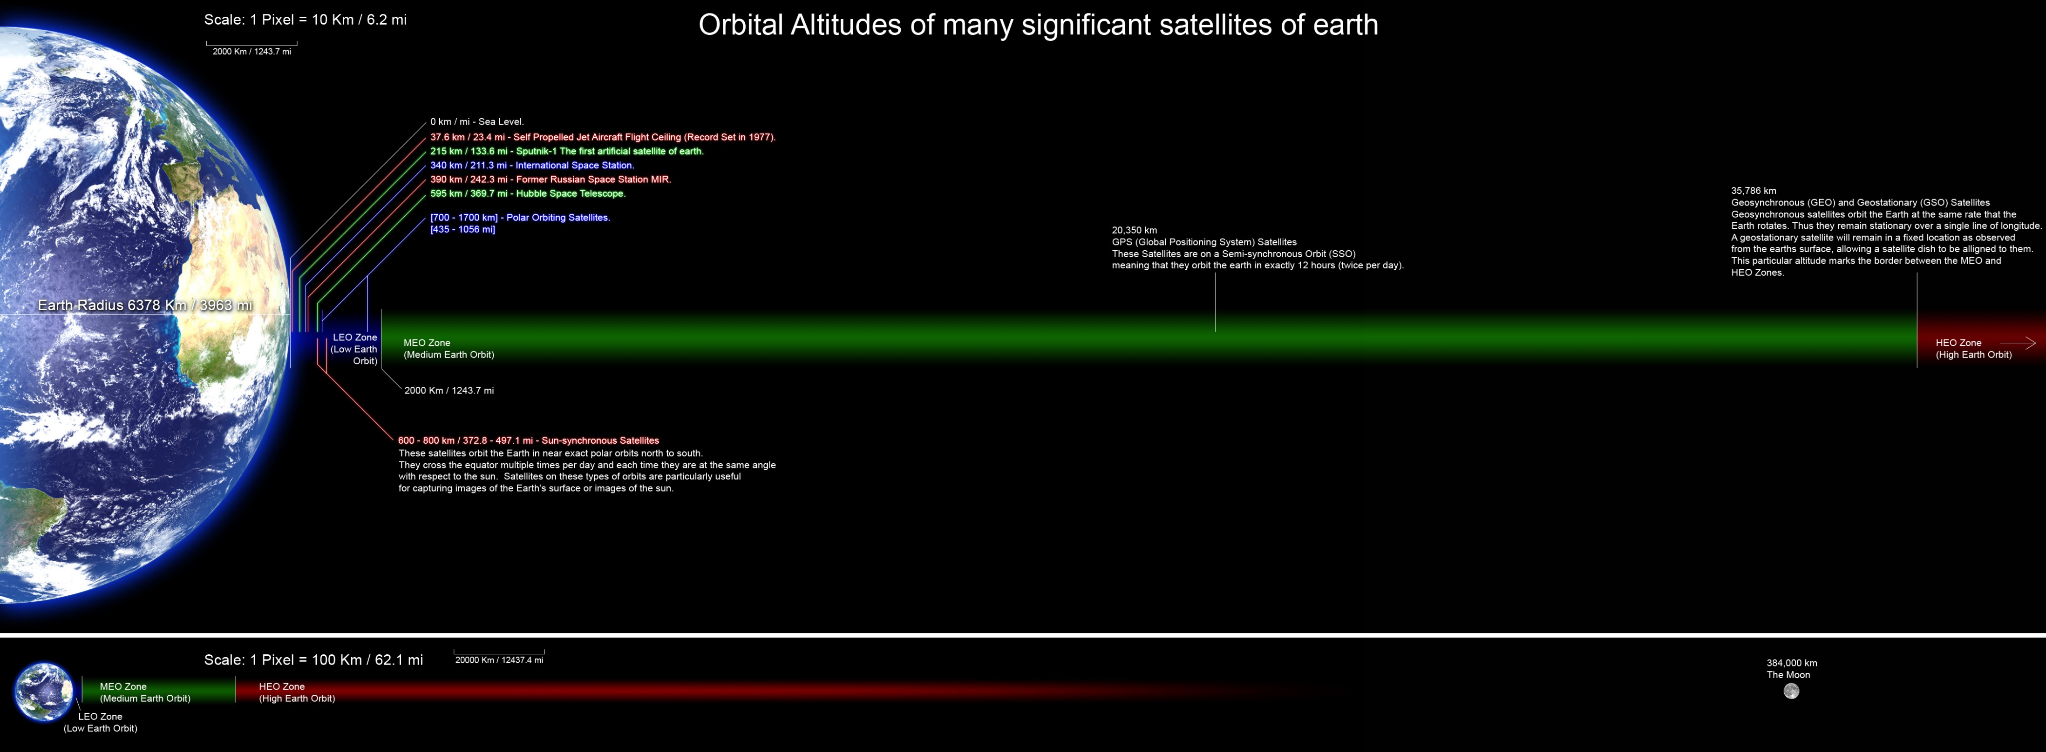
(https://en.wikipedia.org/wiki/Satellite#/media/File:Orbitalaltitudes.jpg)

Slide 64
Satellites by inclination
Inclination measured as deviation from alignment with the equator
Equatorial (0◦ inclination)
Polar (90 ◦ inclination)
e.g. GPS satellites have an inclination of roughly 55 ◦
Sun-synchronous
specific combination of inclination and altitude
Maintains constant relationship with the Sun
e.g. can ensure satellite is always in sunlight so solar panels can always function
Useful for imaging, weather satellites and spying

Slide 65
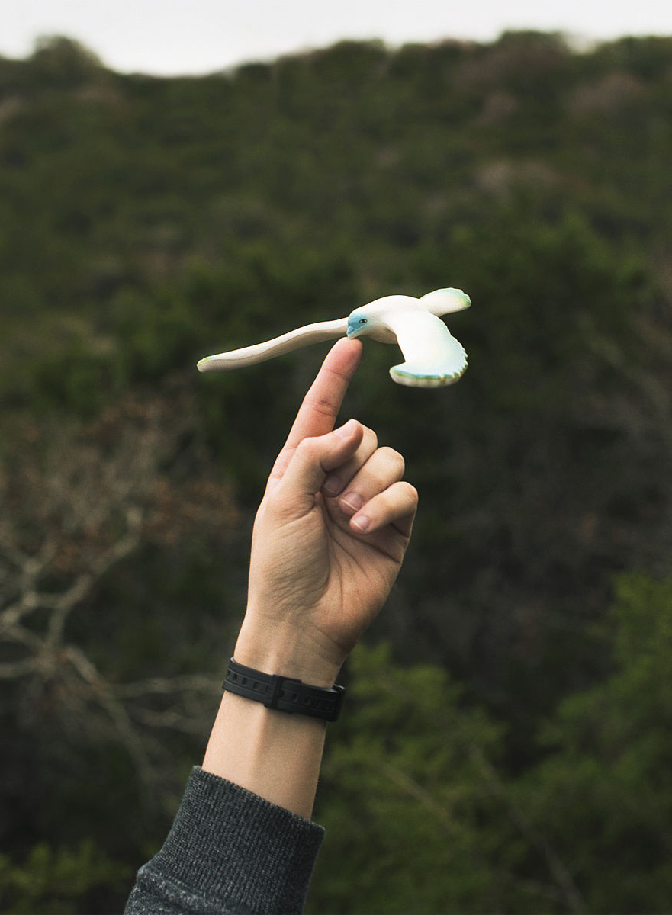
Centre of mass
Centre of mass is the single point where the weighted relative position of the distributed mass sums to zero
Located at the geometric center of an object (assuming homogenous density)
The point at which you could balance the object on your finger
It is the point that a uniform force can be though of as acting on the object
If a force is applied to an object away from its center of mass this causes rotation and ‘torque’
(https://en.wikipedia.org/wiki/Center_of_mass)

Slide 66
Stability
An object will fall over if its weight vector is outside its base of support
Weight vector acts down from center of mass
Increase stability by:
Lowering the center of mass
Widening the base
E.g. wine glass vs whisky glass vs tumbler

Slide 67

Torque τ
$$τ=rF\sin{θ}$$
τ = torque (N m)
r = radius (m)
F = Force (N)
θ = angle between direction of force and lever arm (often 90◦ eliminating sinθ)
known as ‘torque’, ‘moment of force’, or just ‘moment’
measure of rotational force
symbol τ (lower case Greek letter tau)
pseudovector so has magnitude and direction

Slide 68
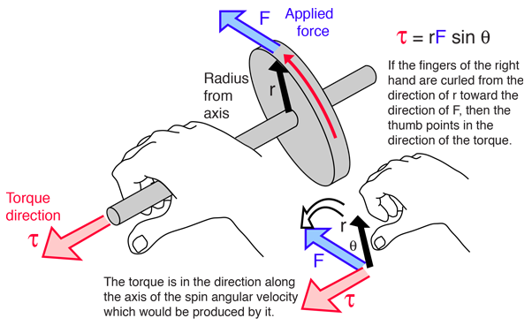
Direction for Torque
Torque does require a direction
For our purposes just give a descriptive direction, often clockwise or counter-clockwise but this is not following convention
The conventional direction of a torque is perpendicular to both the direction of the force and the direction of the lever arm, determined using the right hand grip rule
At our level this can be ignored but it has significance when dealing with angular momentum
(http://hyperphysics.phy-astr.gsu.edu/hbase/tord.html)

Slide 69

Example 1
What torque is created when holding a 4 kg 1.3 m plank out in front of you?
$$τ=rF\sin{θ}$$
$$τ=0.65×4×9.8\sin{90}$$
$$τ=25.5 N m$$

Slide 70

Example 2
A woman whose car has a flat tyre has two wheel-nut spanners in the boot of her car. One wheel spanner is 15 cm long, the other is 75 cm long.
Which spanner will require least effort?
The 75 cm long spanner, longer lever arm so for the same torque less force is required
If the woman is capable of exerting a force of 45 N perpendicular to the spanners what is the maximum torque she can apply?
$$τ=0.75×45=33.8 N m clockwise or anti−clockwise$$

Slide 71

Example 3 – Method 1
30°
12 N
Determine the torque in scenario shown in the diagram
$$τ=rF\sin{θ}$$
$$τ=1.5×12\sin{60}$$
$$τ=15.6 N m anticlockwise$$
Can be thought of as finding component of force perpendicular to lever arm
1.5 m

Slide 72

Example 3 – Method 2
30°
12 N
Determine the torque in scenario shown in the diagram
Can project force back so it is perpendicular to a different lever arm
Find length of new lever arm (should always be smaller)
$$lnew=1.5\cos{30}$$
$$lnew=1.30 m$$
Then find torque as if the force were perpendicular to this lever arm (force does not change size!)
$$τ=1.3×12$$
$$τ=15.6 N m anticlockwise$$
Can be thought of as finding effective shorter lever arm
1.5 m

Slide 73

Example 4 – center of mass
Timmy wants to determine the center of mass of a 5.45 m long crocodile. He wrangles it onto two scales. Scale A sits 1.73 m back from the tip of the croc’s head and reads 564 kg. Scale B sits 2.1 m up from the tip of the croc’s tail and reads 422 kg. Find the location of the crocodile’s center of mass.
$$treat center of mass as pivot$$
$$τ_{clockwise}=τ_{anticlockwise}$$
$$564×9.8×x=422×9.8×\left(\left(5.45−1.73−2.1\right)−x\right)$$
$$564x=422\left(1.62−x\right)$$
$$564x=683.64−422x$$
$$986x=683.64$$
$$x=0.693 m back from scale A$$
$$so 2.42 m from the tip of the crocodile^{′}s head$$

Slide 74

Equilibrium
For a rigid body to be in equilibrium the sum of all forces and the sum of all moments on the object must be zero
$\sum{F=0}$ $\sum{τ=0}$
This is referred to as static equilibrium and requires both translational and rotational equilibrium
Therefore there is:
No net force
No acceleration

Slide 75

General equilibrium problem methods
Identify beam
Draw in all the forces acting on a beam
Choose pivot point to cancel unknown force
$$τc=τac$$
$$Fup=F_{down}$$
$$Fleft=Fright$$

Slide 76

Example 1
Is the system below balanced?
$$τanticlockwise=4×3 x 9.8=118 N m anticlockwise$$
$$τclockwise=6×2x9.8=118 N m clockwise$$
$$\sum{τ}=118−118=0 N m$$
It is balanced
4 m
6 m
3 kg
2 kg

Slide 77

Example 2
Is the system below balanced?
$$τanticlockwise=\left(3×3+3×5\right)x 9.8=24 x 9.8N m anticlockwise$$
$$τclockwise=\left(4×6\right)x9.8=24x 9.8 N m clockwise$$
$$\sum{τ}=235−235=0 N m$$
It is balanced
5 m
3 m
6 m
3 kg
3 kg
4 kg

Slide 78

Example 3
A 20 m long bridge with a weight of 100000 N spans a valley. A 200000 N truck sits 6 m from one end (A) of the bridge. Find the reaction force at each end, A and B.
$$Treating A as the pivot eliminates R1$$
$$τc=τac=6×200000+10×100000=20×R2$$
$$R2=110 000 N$$
$$Treating B as the pivot eliminates R2$$
$$τac=τc=14×200000+10×100000=20×R1$$
$$R1=190 000 N$$
$$Can check answer$$
$$\sum{Fup}=\sum{Fdown}=200000+100000=110000+190000$$
R₁
R₂
A
B
200000 N
100000 N

Slide 79
Example 4
While painting a tall building, a 70.09 kg painter stands 4.00 m form the end of a 6.00 m long plank that is supported by a rope at either end. The plank has a mass of 320.0 kg. Determine the tension in each rope.

Slide 80
Example 5
A uniform cantilever beam used as a viewing platform extends 10.0 m beyond two supports which are 8.00 m apart. If the beam has a mass of 30.0 kg, determine the magnitude and direction of the forces that the supports must supply so that the beam is in static equilibrium.

Slide 81
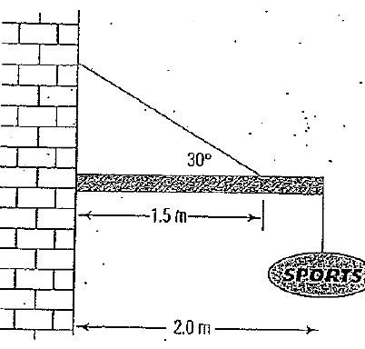
Example 6
A 10.2 kg sign is suspended from the end of a uniform 2.00 m long,
25.5 kg weight cantilevered beam outside a shop. The beam is further supported by an effectively light wire that makes an angle of 30.0⁰ to the beam. The wire is attached at a point 1.5m from the wall.
Find the tension in the wire.
Determine the force acting on the beam supplied by the wall.

Slide 82
Rules for a ladder
Draw diagram.
Draw in weight of ladder and weight of person on ladder.
Reaction force at top of ladder will be perpendicular to surface it is applied to. (wall is horizontal)
Direction of Reaction force of ground is NOT up the ladder. Usually pivot is placed here.

